Slide 1
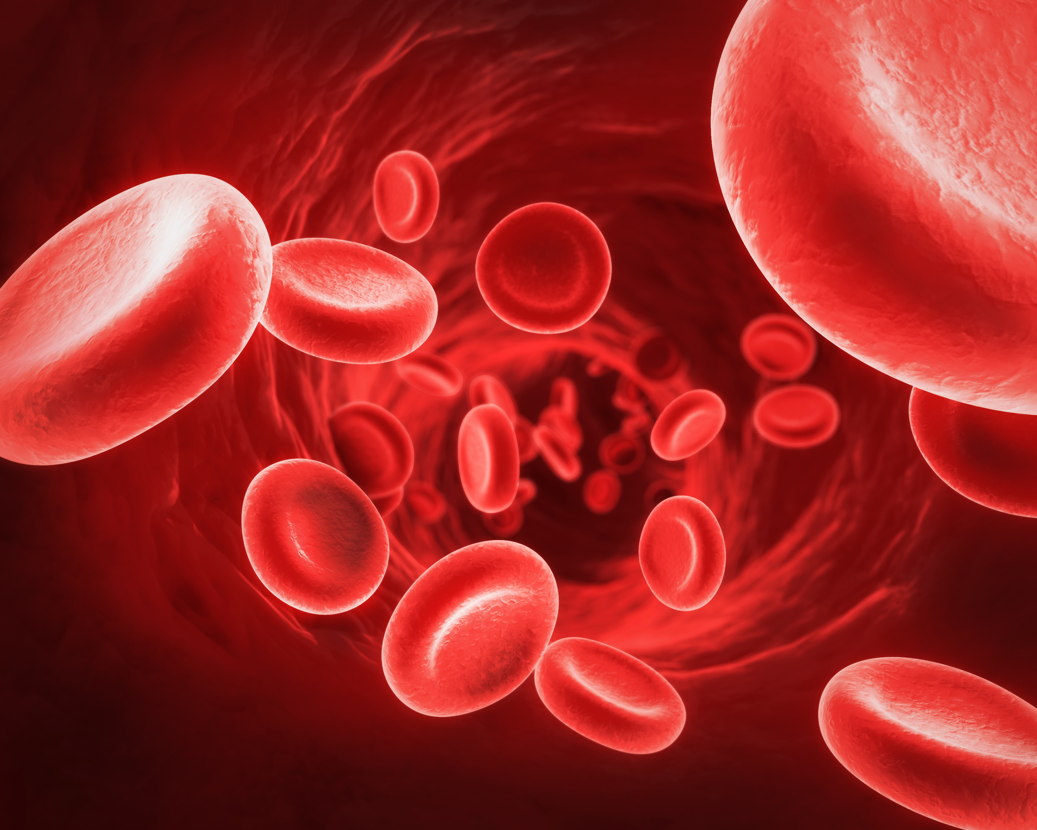
Hemophilia A and Coagulation Factor 8
Allison Christensen
http://www.interactive-biology.com/wp-content/uploads/2012/07/RedBloodCells3.jpg

Slide 2
Hemophilia A
http://www.koate-dviusa.com/filebin/images/patient/about_hemophilia_a.jpg
Notes:
Bleeding disorder
Symptoms- uncontrollable, or longer bleeding times.
1/5000 males have a form of Hemophelia A, very few women.

Slide 3
Genetic Basis of Hemophilia A
Inherited X-linked recessive
30% result from random mutations
Cause - mutated coagulation Factor 8
Mild (reduced F8)
Moderate
Severe (little to no F8)
Mild or moderate - insertions, deletions or single base pair changes
Severe - large inversion

Slide 4
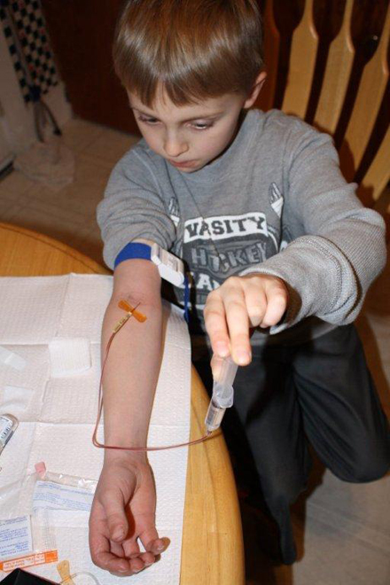
Treatment
Replace with F8 concentrates at injury site
Many with severe Hemophilia A develop inhibitors
http://www.hemophiliafed.org/uploads/kari_atkinson_iowa_4401.jpg

Slide 5
Mutations in Factor 8 cause Hemophilia A
Intron 1 inversion
Intron 22 inversion
F8 Human
2351
Gene ontology
Biological-Coagulation
Cellular-Platelet’s extracellular granule alpha lumen
Molecular-Copper ion-binding substance
Green- Multicopper oxidase type 3
Light blue- Multicopper oxidase type 2
Purple- F5/8 type C
Notes:
Multicopper oxidases- Control homeostasis by binding copper ions, which is hazardous floating in the body.
F5/8 Type C domain- promotes binding to anionic phospholipids on the surface of platelets and endothelial cells
Most common severe mutations include inversions in intron 1 and 22. Large deletions/insertions anywhere in F8 also usually cause severe hemophilia. However, thousands of different mutations everywhere in the gene have been found, ranging from mild to severe.
Contained on the X chromosome on the end of the long arm.

Slide 6
Factor 8 Homolog Domains
F8 Human
2351
F8 Mouse
2319
F8 Rat
2258
F8 Zebrafish
1670
Hml Drosophila
3482
Green- Multicopper oxidase type 3
Light blue- Multicopper oxidase type 2
Purple- F5/8 type C
Red- Von Willebrand type D
Navy- C8
Royal blue- Trypsin Inhibiter-like cysteine rich

Slide 7
Factor 8 is conserved

Slide 8
Drosophila Hml domains
Drosophila melanogaster
Red- Von Willebrand Type D
Navy- C8
Blue- Trypsin Inhibiter-like cysteine rich
Purple- F5/8 Type C
Notes:
I chose drosophila as a model, because it doesn’t have blood but contains the highly conserved F5/8 domains. Easy to use.
Von Willebrand Type D-stopping the blood flow or loss of blood. Firstly, it causes platelets to adhere to the inside of the damaged blood vessel walls to prevent leakage of blood, and is a carrier protein for F8.
C8- Found on many disease-related proteins
Trypsin Inhibitor-like cysteine rich- This family contains trypsin inhibitors as well as a domain found in many extracellular proteins.

Slide 9
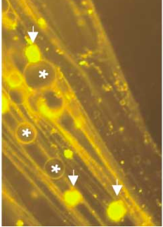
Flies have blood? Hemolymph
Hemolymph becomes viscous from formations of fibers
Hemocytes and fat body fragments rush to clot
Entraps bacteria; Hemocytes normally perform cell ingestion (phagocytosis)
Notes:
Clear Blue when oxygenated, grayish when not. Contains many proteins. When clotting happens, hemocytes (cells that hold hemolectin) and fat body fragments rush to area to combine with fibers. Hemolymph initially entraps bacteria which are then ingested (phagocytosis) by Hemocytes.

Slide 10
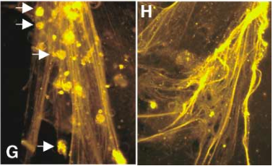
Phenotypes of mutant Hml gene in Drosophila melanogaster
Mutants in Hml allow the flies to live but they cannot clot their hemolymph properly
Notes:
Note that the fibers are intact, but the hemocytes are missing.

Slide 11
Hypothesis: The F5/8 domain is important for clotting
Questions to test: When the F5/8 domains are mutated, does the hemolymph still clot normally?
F5/8 most conserved domain in Hml
Knock out F5/8 domain in Hml flies using RNAi
Wound flies
Compare wound in WT to defective flies over time
Mutant
WT
Wound size
Hours

Slide 12
Amino acids targets

Slide 13
Hypothesis: Immune response is important for blood clotting or Hml function
In mutated Hml, immune response is affected because the hemocytes that contain Hml ingest bacteria

Slide 14
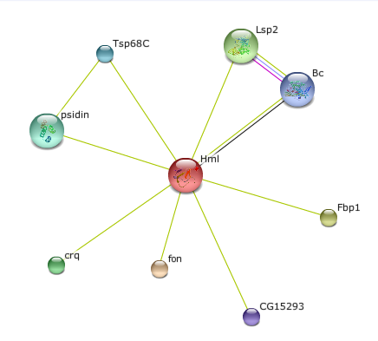
What factors are important for immune response in flies?

Slide 15
Psidin protein is essential for immune response
NatB MDM20: Regulates tropomyosin-actin interactions
Human ortholog: NAA25; tied to autoimmunity in diabetes
Phenotypes: hemocytes and melanotic mass
Regulates activation of immune response
Border follicle cell migration
string-db.org
Notes:
Melanotic masses mostly linked to hemocyte-mediated immune response (small mass, usually not invasive)

Slide 16
Create Hml-mutated fly with a large deletion
Use a microarray
Compare Psidin expression in mutated Hml flies to wildtype flies
 | Expression Psidin | Expression Hml
Normal Hml | Normal | Normal
Mutant Hml | Lower | Lower
Notes:
Large deletions are most likely to form inhibitors in humans.
In an Hml-mutated fly, I plan to look at the expression of proteins that are key in immunity. It is known that some types of severe cases of hemophilia create an antibody to the F8 concentrates given to them. This shows us that there may be an over-active immune system at play.

Slide 17
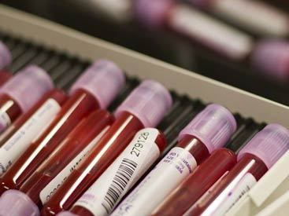
Future
Complete expression tests for the other factors that may influence immunity in mutant Hml flies
Understand how coagulation functions in drosophila to create new drug therapies for Hemophilia A
http://dawncompk.files.wordpress.com/2011/12/blood-samples-r543.jpg?w=670
Notes:
Maybe the

Slide 18
References
(2013, 05 07). Multiple Sequence Alignment [Web Graphic]. Retrieved from http://www.ebi.ac.uk/Tools/services/web/toolresult.ebi?jobId=clustalw2-I20130506-152125-0784-8017202-pg&tool=clustalw2&showColors=true
Gouw, S. C., et al. (2012). F8 gene mutation type and inhibitor development in patients with severe hemophilia a: systematic review and meta-analysis. Blood, 119(12), 2922-34. doi: doi: 10.1182/blood-2011-09-379453
Ahmad, S. (2007). Insect immunity: The psidin adventure. Immunology: Nature reviews, (7), 90-91. doi: doi:10.1038/nri2030
Kisand, K., & Uibo, R. (2012). Lada and t1d in estonian population - two different genetic risk profiles. Genetica, 497(2), 285-91. doi: doi: 10.1016/j.gene.2012.01.089.
Minakhina, S., & Steward, R. (2006). Melanotic mutants in drosophila: Pathways and phenotypes. Genetics, 174(1), 253-263. doi: doi: 10.1534/genetics.106.061978

